Slide 1
Introduction to Computing
ENGR. SAJID SALEEM

Slide 2
Outline
History / Evolution of Computers
CPU Evolution (Intel)
Computer Memory Evolution
Hard Disk Drive / Solid State Drive Interface
Compact Disc Speeds
USB Flash Drive Interface
DDRRAM Speeds
Binary Units

Slide 3
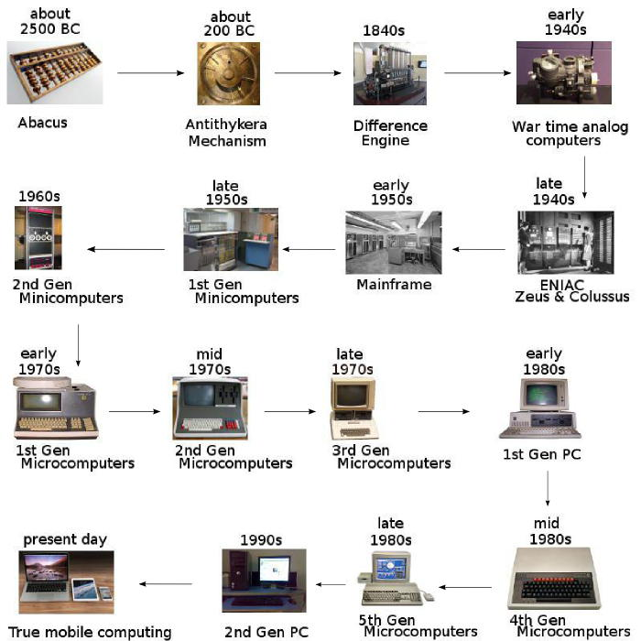
https://www.juniorcoders.ca/blog/how-computers-evolved/

Slide 4
Intel
AMD
Central Processing Unit
(CPU)

Slide 5
(1974)8080
(1977)8085
(1978)8086
(1979)8088
(1993) Pentium Processor
(1995) Pentium Pro
(1997) Pentium II
(1999) Pentium III
(2000) Pentium IV
(2003) Pentium M
(2006) Core 2
(2011) Core i3/i5/i7
(1972)8008
(1971)4004
Intel CPU History
https://techspirited.com/history-of-computer-processors

Slide 6
Computer Memory
Internal/Main/Primary
External/Secondary
RAM
(Volatile)
ROM
(Non-Volatile)
SRAM
DRAM
SDRAM
RDRAM
DDRRAM
DDR1
DDR2
DDR3
DDR4
HDD
SSD
(DRAM/DRAM-less)
Compact Dics
USB Flash Drive
SATA
M.2
NVME
IDE/PATA
SATA
USB 1.0/1.1
USB2.0
USB 3.0/3.1/3.2

Slide 7
HDD
SSD
(DRAM /
DRAM-less)
SATA (as shown)
M.2 (Similar to SATA Standard speeds)
NVME 3000MB/s and above
IDE/PATA
SATA
100MB/s
SATA 150MB/s
SATA II 300MB/s
SATA III 600MB/s

Slide 8
Compact Disc
Drive speed | Transfer rate (Mbit/s) | Access time (ms)
Single speed (1x) | 1.2288 | 400
Double speed (2x) | 2.4576 | 300
Quad speed (4x) | 4.9152 | 150
Six speed (6x) | 7.0653 | 150
Eight speed (8x) | 9.8304 | 100
Ten speed (10x) | 12.288 | 100
Twelve speed (12x) | 14.7456 | 100
Eighteen speed (18x) | 21.8343 | 90
Twenty speed (20x) | up to 24.576 | 90
Thirty-two speed (32x) | up to 39.3216 | 85
Thirty-six speed (36x) | up to 44.2368 | 80
Fifty-two speed (52x) | up to 63.8976 | 80
Seventy-two speed (72x) | up to 88.4736 | 75
https://www.computerhope.com/jargon/c/cdrom.htm

Slide 9
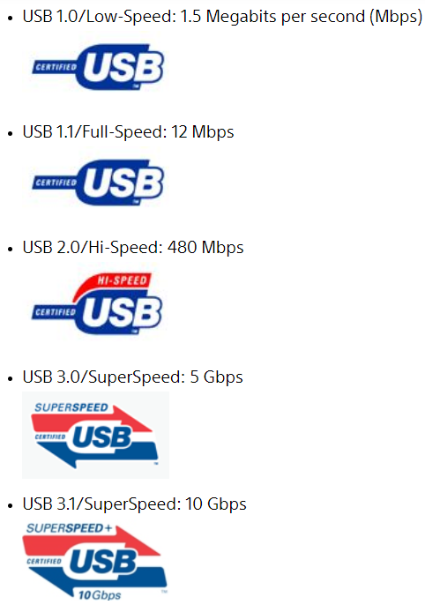
USB Flash Drive
https://www.sony.com/electronics/support/articles/00024571

Slide 10
DDR RAM
Friendly name | Industry name | Peak Transfer Rate
DDR-200 | PC-1600 | 1600 MB/s
DDR-266 | PC-2100 | 2100 MB/s
DDR-300 | PC-2400 | 2400 MB/s
DDR-333 | PC-2700 | 2700 MB/s
DDR-400 | PC-3200 | 3200 MB/s
DDR3-800 | PC3-6400 | 6400 MB/s
DDR3-1066 | PC3-8500 | 8533 MB/s
DDR3-1333 | PC3-10600 | 10667 MB/s
DDR3-1600 | PC3-12800 | 12800 MB/s
DDR4-2400 | PC4-19200 | 19200 MB/s
DDR4-2666 | PC4-21300 | 21300 MB/s
DDR4-2933 | PC4-23400 | 23400 MB/s
DDR4-3000 | PC4-24000 | 24000 MB/s
DDR4-3200 | PC4-25600 | 25600 MB/s
DDR4-3600 | PC4-28800 | 28800 MB/s
DDR4-4000 | PC4-32000 | 32000 MB/s
DDR4-4400 | PC4-35200 | 35200 MB/s
DDR2-400 | PC2-3200 | 3200 MB/s
DDR2-533 | PC2-4200 | 4266 MB/s
DDR2-667 | PC2-5300 | 5333 MB/s
DDR2-800 | PC2-6400 | 6400 MB/s
DDR2-1000 | PC2-8000 | 8000 MB/s
https://www.crucial.com/support/memory-speeds-compatability

Slide 11
Binary Units

Slide 12
THANK YOU

